Slide 1

Underwriting with Prescription Histories Across the Mental Health Continuum
Carolina Underwriters Forum
October 10, 2019
Proprietary and Confidential

Slide 2
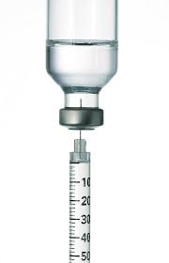
Agenda
Neurotransmitter Review
Define Psychotropic Medications
Psychiatric Conditions
Rule Engine Interprets Psych Meds
Proprietary and Confidential

Slide 3
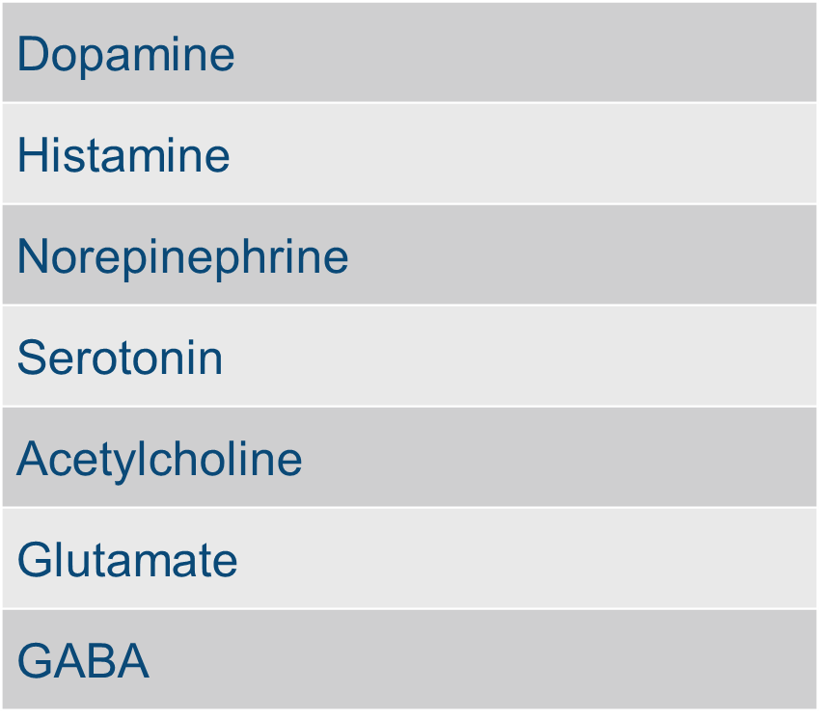
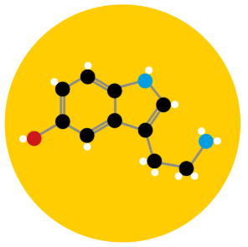
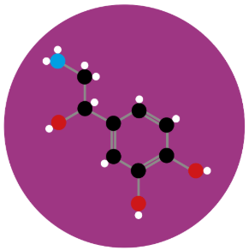
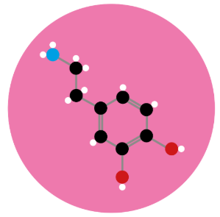
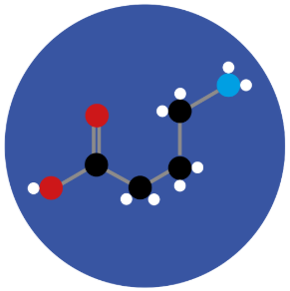
Drug therapies impact many neurotransmitters.
Serotonin
Norepinephrine
Dopamine
GABA
Proprietary and Confidential

Slide 4
Neurotransmitters influence a wide range of mental states.
Dopamine &
Histamine
Cognition
(Mental Alertness)
Norepinephrine & Acetylcholine
Vigilance
(Sustained Concentration)
Attention
MOOD
Appetite
Intuition
Serotonin &
Glutamate
Perception
(Sensory Satisfaction)
GABA
Proprietary and Confidential

Slide 5
Doctors prescribe by condition.
Depression
Anxiety
Insomnia
Benzodiazepines
SSRI’s, SNRI’s
Nausea
Tricyclics, Tetracyclics, Modified Cyclics
Neuropathy
Migraine Prevention
Antipsychotics
Anticonvulsants
Tourette’s
Stimulants
Obsessive/Compulsive
GABA Analogs
Bipolar
Bupropion
Schizophrenia
ADHD
Proprietary and Confidential

Slide 6
Underwriters use Rx to interpret conditions.
Depression
Anxiety
Insomnia
Benzodiazepines
Nausea
SSRI’s, SNRI’s
Neuropathy
Tricyclics, Tetracyclics, Modified Cyclics
Migraine Prevention
Tourette’s
Antipsychotics
Obsessive/Compulsive
Anticonvulsants
Bipolar
Stimulants
GABA Analogs
Schizophrenia
Bupropion
ADHD
Smoking Cessation
Epilepsy
Proprietary and Confidential

Slide 7





A Sesame Street mnemonic for mental disorders
ADHD
Depression
Obsessive Compulsive Disorder (Anxiety)
Bipolar Disorder
Schizophrenia
Proprietary and Confidential

Slide 8

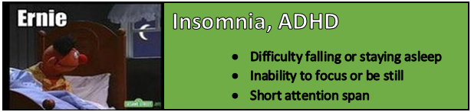
Proprietary and Confidential

Slide 9


ADHD (Adult)
Inattention and/or hyperactivity-impulsivity
  Symptoms at least 6 months
  DIVA 2.0 useful for diagnosis
4.4% of 18-44 year olds
Comorbid with other psych disorders
Higher mortality
  Accidents most common cause of death
Proprietary and Confidential

Slide 10
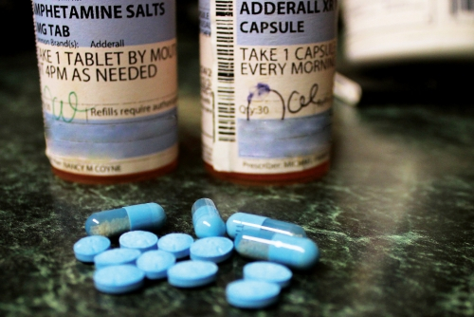
How Medications Treat ADHD
Dopamine and norepinephrine activity
Medications and psychotherapy
  Stimulants
    Methylphenidate
    Amphetamines
  Non-stimulants
    Atomoxetine
    Atypical antidepressants
    Clonidine/guanfacine
Proprietary and Confidential

Slide 11
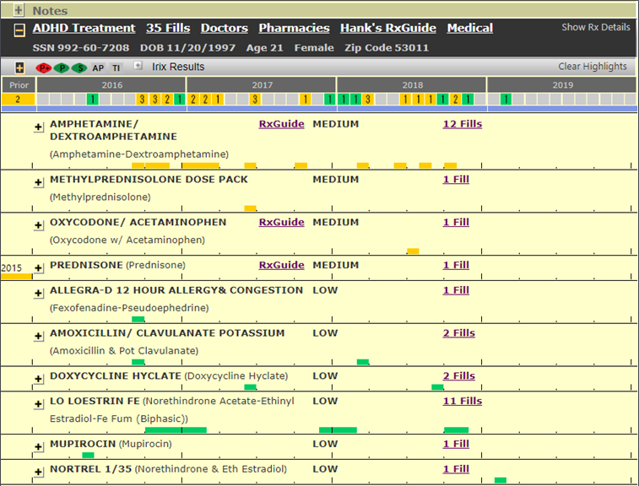
Prescription histories identify conditions.
Proprietary and Confidential

Slide 12
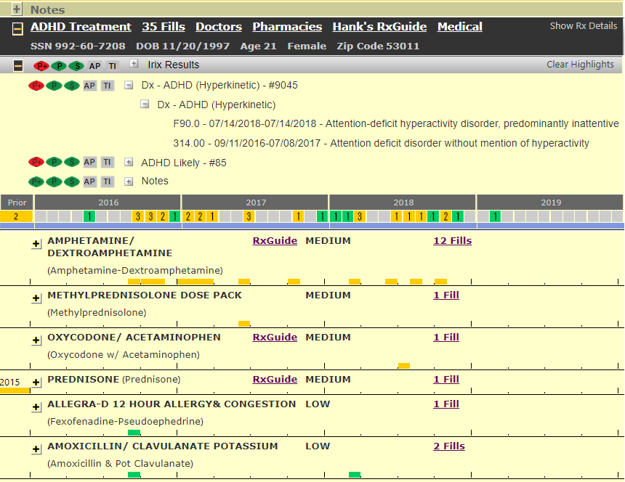
Diagnosis information confirms conditions.
Proprietary and Confidential

Slide 13
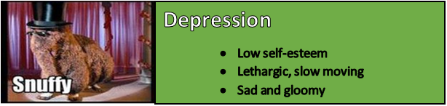
Proprietary and Confidential

Slide 14


Major Depressive Disorder (MDD)
Low mood, low self-esteem, loss of interest
Targets:
  Norepinephrine, Serotonin, Dopamine
SSRI, SNRI
Bupropion
Tricyclics
MAO-I
Antipsychotic
Esketamine
Proprietary and Confidential

Slide 15
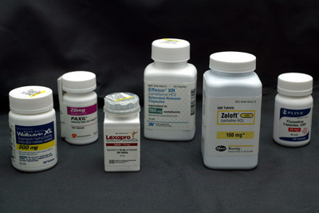
Major Depressive Disorder (MDD)
Single agent
  SSRI or SNRI
Multiple agents, non-concurrent
  Trial and transition
Multiple agents, concurrent
  Antidepressant + Benzodiazepine
  Multiple Antidepressants
  Antidepressant + Antipsychotic
  Antidepressant + Anticonvulsant
Proprietary and Confidential

Slide 16
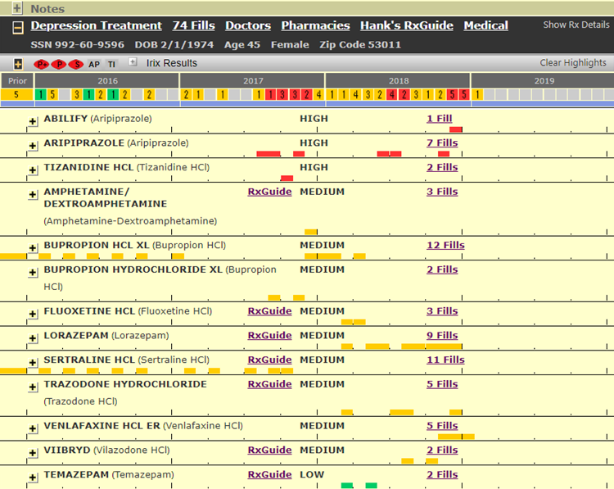
Prescription histories identify conditions.
Proprietary and Confidential

Slide 17
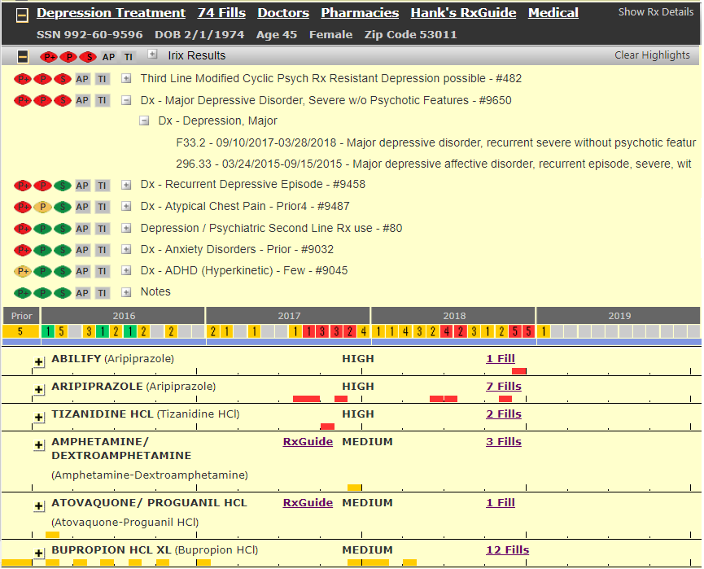
Diagnosis information provides even more information.
Proprietary and Confidential

Slide 18
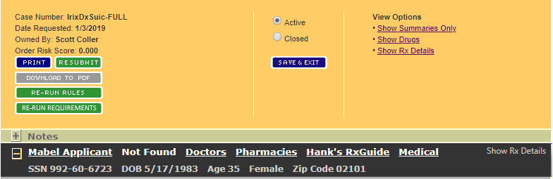
What about Rx no-hits?

Slide 19
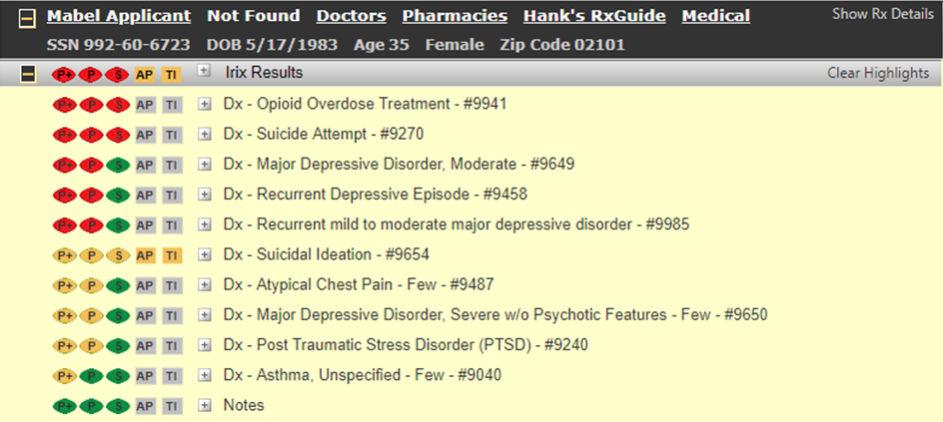
Medical Data identifies more conditions than Rx alone.

Slide 20
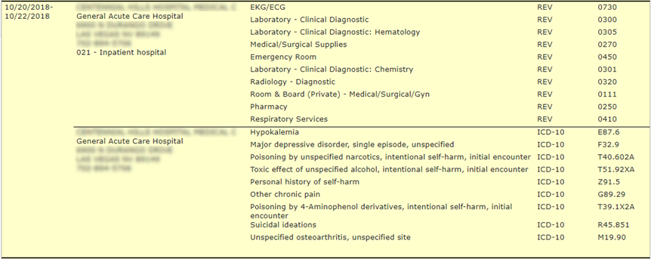
Medical Data identifies more conditions than Rx alone.

Slide 21
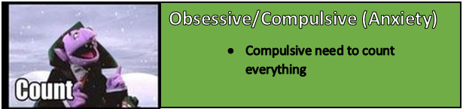
Proprietary and Confidential

Slide 22

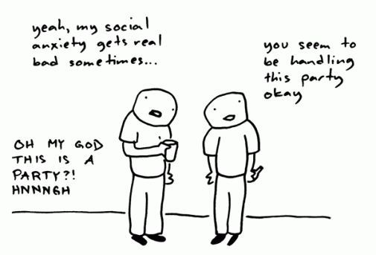
How Medications Treat Anxiety
GAD, Panic, Social Anxiety, Phobias, OCD, PTSD
Targets:
  GABA
  Serotonin
SSRI, SNRI, TCA
Benzodiazepines
GABA analogs
Buspirone
Antipsychotics
Proprietary and Confidential

Slide 23
Estimating Anxiety Progression
SSRI for maintenance, Benzo for breakthrough
Benzodiazepine monotherapy
Pregabalin or buspirone monotherapy
Multiple agents, concurrent
  Combinations of above
  Anticonvulsants
  Antipsychotics
Proprietary and Confidential

Slide 24
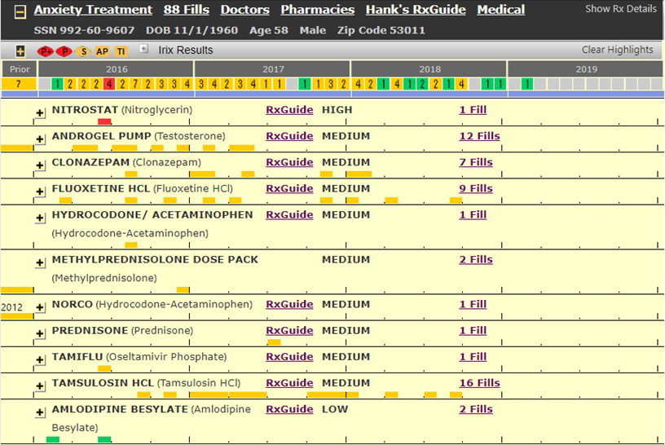
Prescription histories identify likely conditions.
Proprietary and Confidential

Slide 25
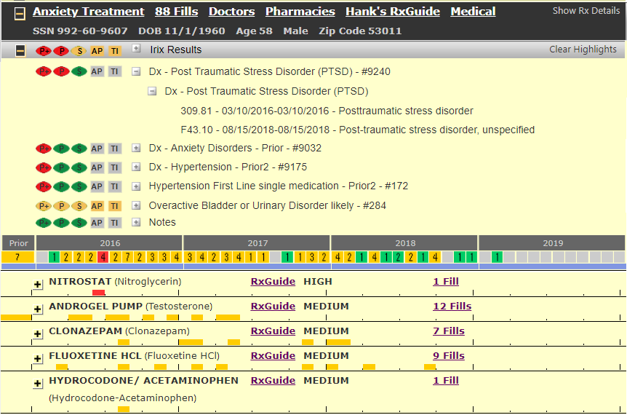
A Rules engine interprets the data.
Proprietary and Confidential

Slide 26
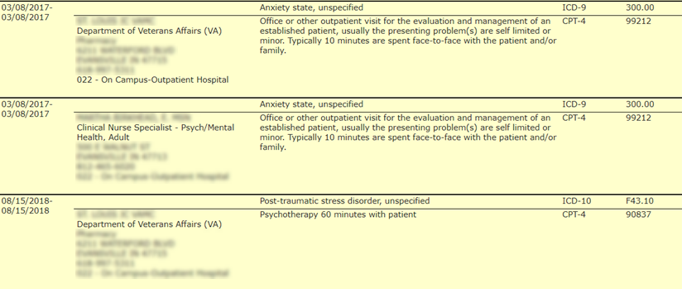
Medical Data identifies more conditions than Rx alone.

Slide 27
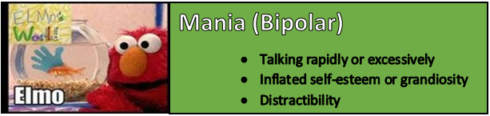
Proprietary and Confidential

Slide 28

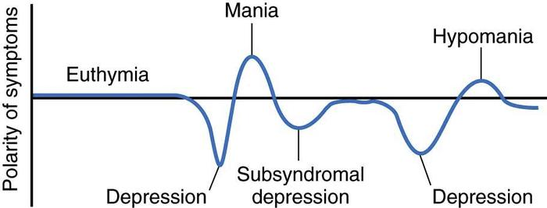
Bipolar Disorder
Periods of mania/hypomania alternating with depression
Bipolar I, Bipolar II, Cyclothymia, Mixed, Rapid Cycling
Proprietary and Confidential

Slide 29
Estimating Bipolar Disorder Progression
Starting therapy:
  Lithium and/or Depakote +/- antipsychotic
  Lithium and/or Lamictal +/- antidepressant
Maintenance:
  Lithium, Depakote, Lamictal, Tegretol, Trileptal, antipsychotics
Proprietary and Confidential

Slide 30
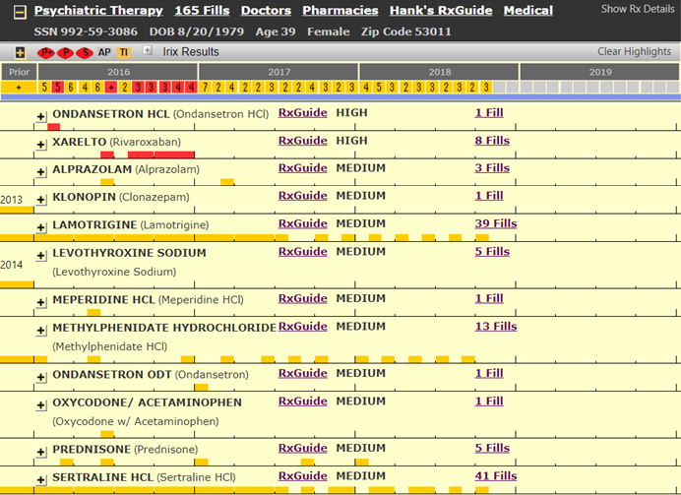
It’s not always easy to identify the fill patterns.
Proprietary and Confidential

Slide 31
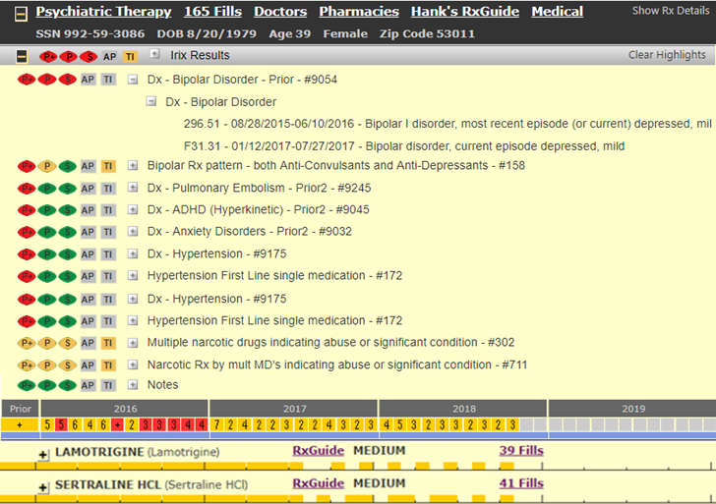
A Rules engine interprets the data.
Proprietary and Confidential

Slide 32
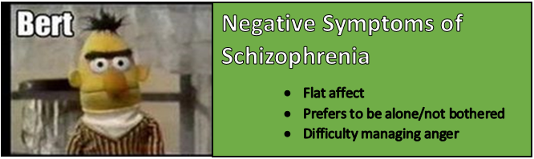
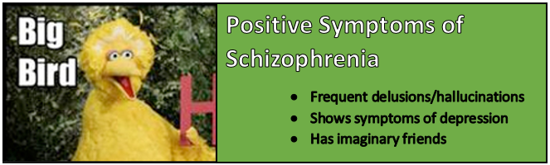
Proprietary and Confidential

Slide 33

Schizophrenia
Suicide risk: At least 2 symptoms present for six months
Cognitive
Poor executive functioning
Positive
Hallucinations
Negative
Flat affect
Delusions
Thought / Movement Disorders
Lack of Pleasure / Drive
Speaks little
Trouble focusing
Problems with working memory
Proprietary and Confidential

Slide 34


Estimating Schizophrenia Progression
Thought disorder, mood disorder, anxiety disorder
Antipsychotics are first line but others may be added
  Clozaril probably most effective
  Cariprazine beneficial with negative symptoms
Three-quarters of all patients stop taking their medications
Proprietary and Confidential

Slide 35
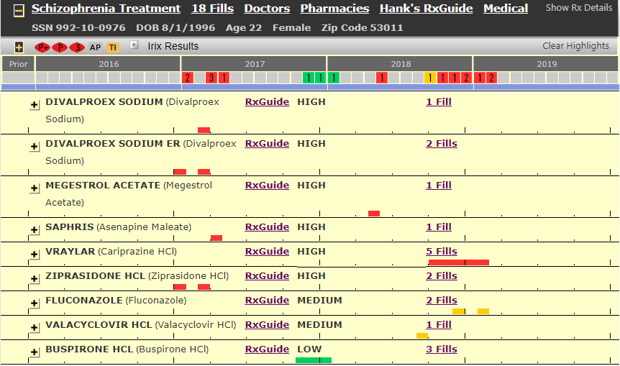
Prescription histories identify conditions.
Proprietary and Confidential

Slide 36
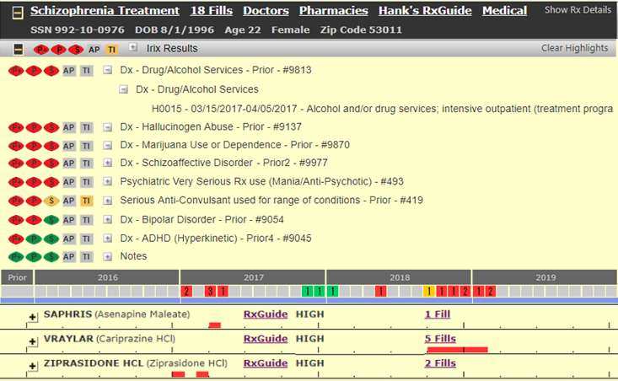
A Rules engine interprets the data.
Proprietary and Confidential

Slide 37
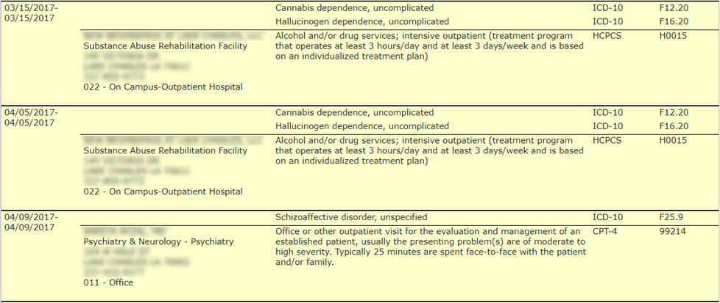
Medical Data identifies more conditions than Rx alone.

Slide 38
A Rules Engine can interpret complex data.
  Classic Data Input
  Rx info
  Medical Data
  Application data
  Other (MIB, MVR)
Rules Engine
  UW Guidance
  Conditions
  Severity
  Decisions
  Risk Score
  Rule Variables
  Indication / Therapeutic class
  Drug combinations
  Fill timing (date or duration ranges)
  Fill counts / patterns
  Dosage / quantity
  Physician specialty / count
  Gender / Age
  Diagnosis / treatment codes
  Other variables
Proprietary and Confidential

Slide 39
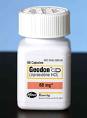
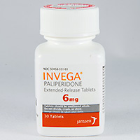
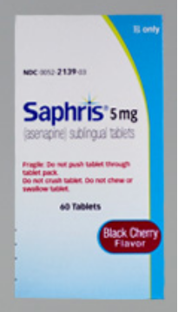
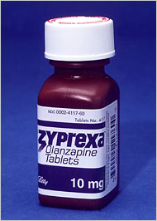
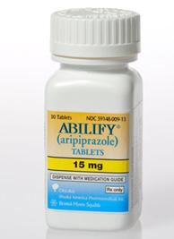
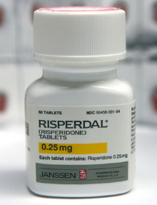
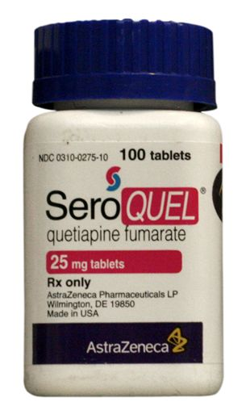
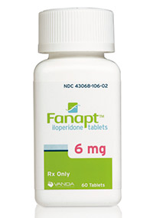
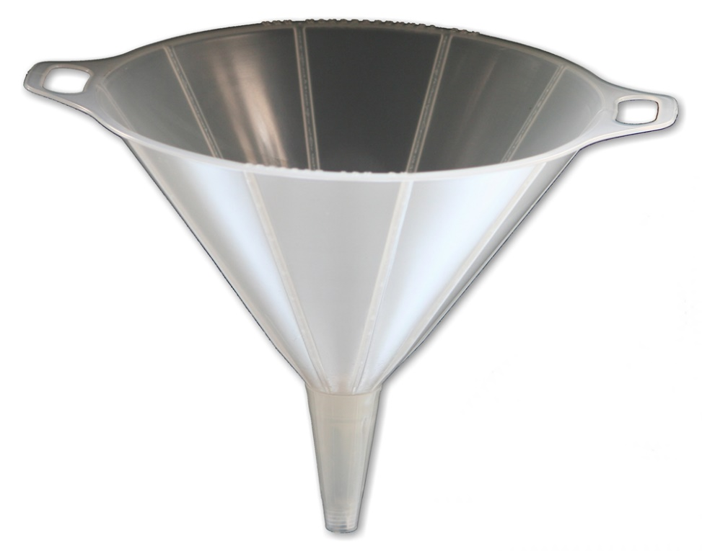
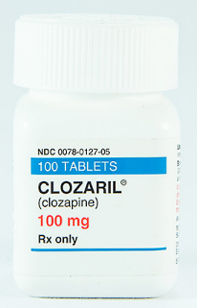
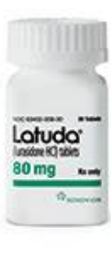

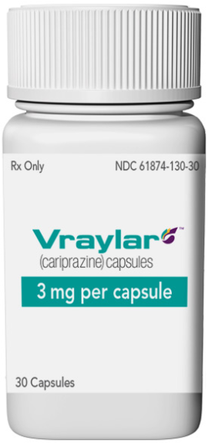
Rules
Treatment-resistant
Depression
Possible
Schizophrenia
Treatment
Likely
Insomnia
Treatment
Likely
Bipolar
Treatment
Likely
Proprietary and Confidential

Slide 40
Underwriting expertise remains as important as ever.
Red / Decline
  Significant rules have “fired”
  Client guidelines drive the decline
  No need for review
Yellow / Review
  Route to underwriter
Green / Issue
  No significant rules “fired”
Proprietary and Confidential

Slide 41
Summary
There is a wide range of psychotropic medications used to treat a wide range of mental health disorders.
It is difficult to reverse engineer medications to determine likely conditions and severity.
A rules engine can bring consistency and efficiency to a very challenging job.
Proprietary and Confidential

Slide 42
Thank you!
Dan Fleischman, PharmD, BCPS – Senior Pharmacy Consultant
October 10, 2019

