Slide 1


Carolina Underwriters Forum
2022 Fall Meeting
Underwriting Opioid Use, Misuse and Use Disorder
Dr. John F. Greene
VP, Chief Medical Director
Underwriting & New Business
October 13, 2022

Slide 2
Opioid Discussion Overview
Opioid facts
Three waves of opioid overdoses in U.S.
Demographics of opioid overdoses in U.S.
Opioid overdoses during time of COVID-19
Industry opioid overdose experience
Underwriting known opioid use
Opioid screening
Case studies
Summary

Slide 3

Opioid Facts
Accidents are the leading cause of death in U.S. adults 50 and under. Of these, accidental drug overdose deaths make up the largest share
Fatal overdoses have quintupled since 1999 (prescription – 17%, heroin – 7%, synthetic – 56%)
In 2020, 92,000 people died from drug overdoses in the U.S.: 80% involved an opioid and 82%, of the opioid deaths, were due to a synthetic opioid, most often illicitly manufactured fentanyl
Fentanyl is up to 50x stronger than heroin & 100x stronger than morphine
Fentanyl is often added to other drugs because of its extreme potency
Fentanyl is relatively easy to synthesize and manufacture, and is less difficult to traffic

Slide 4
Opioids
Natural – Opium (codeine, morphine)
Semisynthetic – Heroin, oxycodone, hydromorphone
Synthetic – Fentanyl, methadone, meperidine

Slide 5
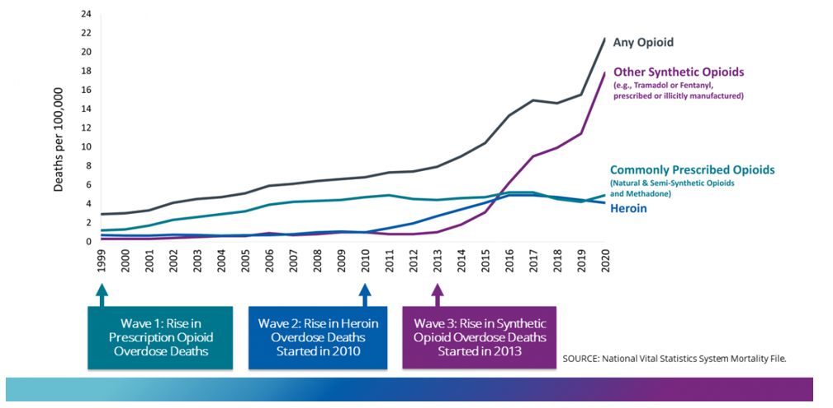
Three Waves Of Rise In Opioid Overdose Deaths
Source: CDC: National Vital Statistics Mortality

Slide 6
U.S. Drug Overdose Deaths; All Ages by Gender: 1999-2020
Source: CDC: National Vital Statistics Mortality

Slide 7
U.S. Drug Overdose Death Rates by Age: 1999-2019
Source: CDC: National Vital Statistics Mortality

Slide 8
U.S. Drug Overdose Death Rates by Race & Ethnicity: 2015-20
Source: CDC: National Vital Statistics Mortality

Slide 9
Drug Abuse Death Rate by Educational Level: 2009-2014
Population Data: Cause-of-Death Public Use Record from the CDC; Insurance Data: Munich Re

Slide 10
Drug Abuse Death Rates
Population Data: Cause-of-Death Public Use Record from the CDC; Insurance Data: Munich Re

Slide 11
Emergency Room Visits for Nonfatal Overdoses: US 1/19-9/20
Source: CDC - National Vital Statistics Mortality

Slide 12
Morphine Equivalents
Opioid medications have different potencies
Determine daily opioid exposure by comparing potency of various opioids to morphine as the standard = morphine equivalent
Morphine is given the potency of 1 and other drugs are given a potency value relative to this standard
The total daily dose of opioids are expressed as a morphine equivalent dose
Relative risk (RR) of fatal overdose by dosage: 0-19 mg (1x), 20-49 mg (1.5x), 50-99 mg (4x), and 100 mg+ (7.5x)

Slide 13
Morphine Equivalent Conversion
Generic Name | Brand Name | Morphine Equivalents
Morphine | MS Contin, Oramorph SR, Avinza, | 1
Tramadol | Ultram, Syapryn, Ryzolt, Rybix | 0.10
Codeine | Tylenol w/ codeine | 0.15
Propoxyphene | Darvon, Darvocet | 0.23
Hydrocodone | Lortab, Vicodin, Norco | 1
Oxycodone | Oxycontin, Percodan, Percocet, Tylox | 1.5
Fentanyl transdermal | Duragesic | 2.4-7.2
Oxymorphone | Opana, Opana ER | 3
Methadone | Methadone, Dolophine | 3-12
Hydromorphone | Dilaudid, Dilaudid HP | 4

Slide 14
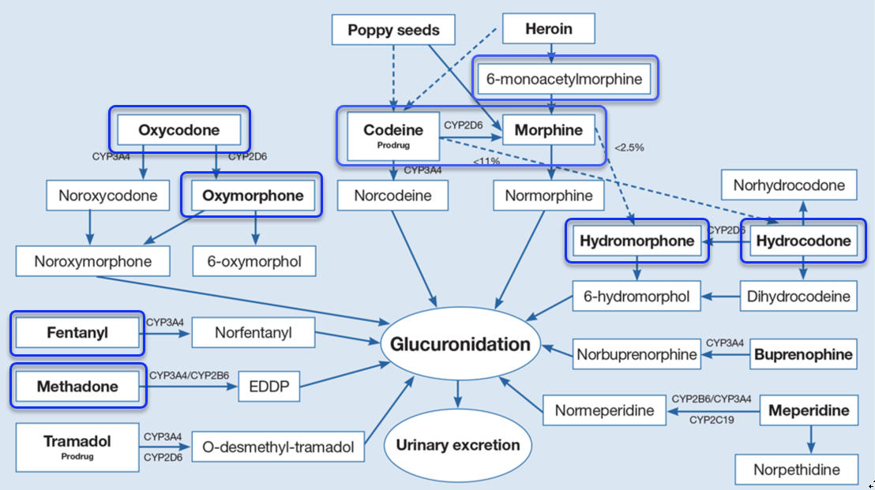
Metabolic Pathways For Commonly Used Opioids

Slide 15
Opioid Testing
Most opioid medications are detectable for about 3 days following use
The length of time opioids are detected in the urine varies due to hydration, dosing, metabolism, body mass, frequency and duration of use
Positive screening results are followed up with confirmatory testing, which helps correct for potential false positive screening results

Slide 16
Case #1
48 y/o male with history of fibromyalgia, chronic back pain and depression.
Current meds: Duragesic, Norco (prn), Valium (prn) and Zoloft.
What additional information would be helpful to assess risk?
Favorable factors?
Unfavorable factors?
Underwriting assessment/offer?

Slide 17
Underwriting Chronic Pain And Prescribed Opioid Use
Severity and duration of client’s pain
Underlying cause of client’s chronic pain?
Calculate and Morphine milligram equivalents (MME)
  https://www.mdcalc.com/morphine-milligram-equivalents-mme-calculator
Impact on function
Use of sedative/hypnotics (benzodiazepines)
Comorbid histories: substance use/misuse and/or psychiatric condition(s)
Who is providing client’s pain related care?
Recent changes in medication regimen – escalating dosages, new medications

Slide 18
Case #1
48 y/o male with history of fibromyalgia, chronic back pain and depression. Current meds: Duragesic (50 mcg/h), Norco (5/325 bid), Valium (5 mg bid), Zoloft (100 mg). Admits to 2 alcoholic drinks daily twice weekly and occasional marijuana use as a sleep aid. Followed by pain specialist.
Calculated MME/day = 130/day - Duragesic = 120 + Norco = 10 MME/day
Unfavorable factors – 2 opioids, MME > 100, use of benzo, comorbid depression, alcohol use, occasional marijuana use, lack of alternative pain treatments, and age
Favorable factors – followed by pain specialist, appears compliant
Underwriting assessment/offer?

Slide 19
Case #2
65 y/o male with history of HTN, hypothyroidism, osteoarthritis with chronic knee and hip pain S/P bilateral knee replacements. Current meds: Tramadol, Vicodin (prn), Naprosyn, Ambien (prn), Synthroid and Lotensin.
What additional information would be helpful to assess risk?
Favorable factors?
Unfavorable factors?
Underwriting assessment/offer?

Slide 20
Case #2
65 y/o male with history of HTN, hypothyroidism, osteoarthritis with chronic knee and hip pain S/P bilateral knee replacements. Current meds: Tramadol 100 mg BID, Vicodin 7.5/300 BID (prn), Naprosyn 250 mg BID, Ambien 10 mg (prn), and Lotensin 20 mg. No alcohol or marijuana use. Swims or walks (2-3 miles/day) 5x/weekly.
MME/day = 20-35 MME/day depending on frequency of Vicodin use (6x/month)
Favorable factors – stable opioid dosage over years, using non-opioid meds, active, no alcohol or marijuana use, no comorbid psych or substance abuse histories, and age
Unfavorable factors – 2 opioid medications, use of sedative-hypnotic for sleep
Underwriting assessment/offer?

Slide 21
Case #3
50 y/o female with history of opioid use disorder who completed inpatient treatment 3 years ago and has been on Methadone since.
What additional information would be helpful to assess risk?
Favorable factors?
Unfavorable factors?
Underwriting assessment/offer?

Slide 22
Case #3
50 y/o female with history of opioid use disorder who completed inpatient treatment 3 years ago. Became addicted to opioids following sports related knee injury w/ subsequent surgery. Current Meds: Methadone 10 mg BID and Lexapro 10 mg. Client is married and working. No alcohol use since her drug treatment. Smokes marijuana a couple times per month. Methadone titration discussed but not attempted.
MME/day = 80
Favorable factors – stable Methadone dosage, no alcohol usage, attending NA meetings, no sedatives, married and working
Unfavorable factors – MME = 80/day, no titration of Methadone dosage, Marijuana use, Lexapro use (anxiety history)
Underwriting assessment/offer?

Slide 23
Case #4
45 y/o male with history of migraine headaches. Lab results are positive for Oxycodone and Oxymorphone.
What additional information would be helpful to assess risk?
Favorable factors?
Unfavorable factors?
Underwriting assessment/offer?

Slide 24
Case #4
45 y/o male with history of migraine headaches. No admitted opioid use. Rx results demonstrate a distant hydrocodone script. No psych history. Admits to 2 alcoholic drinks twice weekly.
What additional information would be helpful to assess risk? Rx results
Favorable factors - No psychiatric history
Unfavorable factors - Unadmitted opioid use. Admits to 2 alcoholic drinks twice weekly
Underwriting assessment/offer?

Slide 25
Case #5
55 y/o male without reported medical histories. Insurance labs are positive for morphine and codeine. No reported opioid use with clean Rx results. You declined client but he appeals your decision based on regular poppy seed usage.
Can eating poppy seeds cause a positive morphine & codeine screen?
Underwriting assessment/offer?

Slide 26
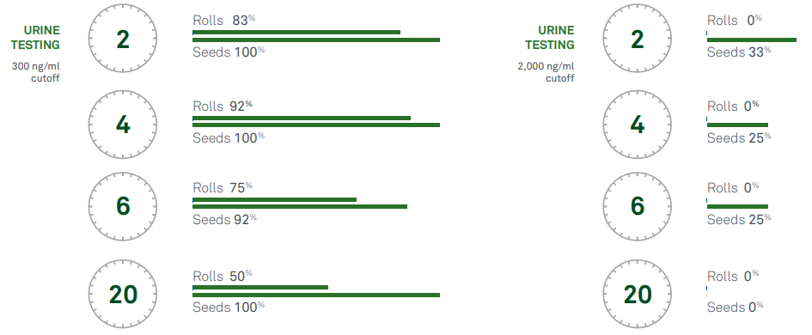
% of Morphine Positive Urines w/ Raw and Roll Poppy Seeds
Source: QuestDiagnostics.com

Slide 27

Summary
Opioids represent the most commonly abused class of medications; 80% of drug overdoses involve an opioid; most being due to a synthetic opioids (illicitly manufactured fentanyl)
Life insurance clients are much less likely to misuse opioids than are those in the general U.S. population
Most chronic pain related overdose deaths occur secondary to accidental overdose
About 35-40% of opioid misusers are taking meds prescribed to them
Not all opioids are the same… calculate morphine equivalents
Understanding the factors that favorably and unfavorably impact overdose risk helps with risk stratification; these factors + MME/day are the basis of your risk assessment for known opioid users

Slide 28
Thank You
Insurance products issued by The Lincoln National Life Insurance Company, Fort Wayne, IN and Lincoln Life & Annuity Company of New York, Syracuse, NY. Variable products distributed by Lincoln Financial Distributors, Inc. Members of Lincoln Financial Group.
The Lincoln National Life Insurance Company does not solicit business in the state of New York, nor is it authorized to do so.

